Slide 1


EcoAdventure
(Sustainable travel planning application)
GABRIEL AGUIRRE
ALISSON CLAVIJO
ADRIAN IZA
ANDRES JACOME
BRYAN YAGUARSHUNGO
members:

Slide 2

Introduction
01

Slide 3

Product Name:
EcoAdventure (Sustainable travel planning application)

Slide 4
Purpos
02

Slide 5
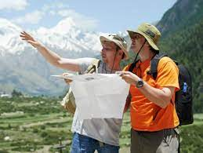
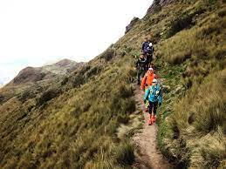
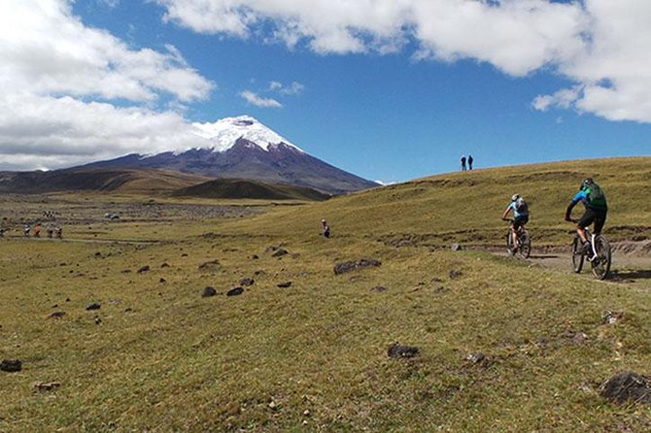
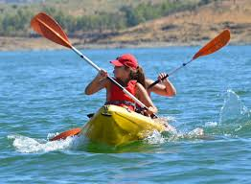
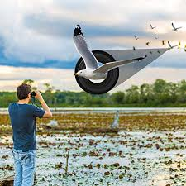
The purpose of this document is to establish the functional and non-functional specifications.
Regarding the EcoAdventure application, its purpose is to connect travelers with local expert guides.

Slide 6
Personnel involved
03

Slide 7
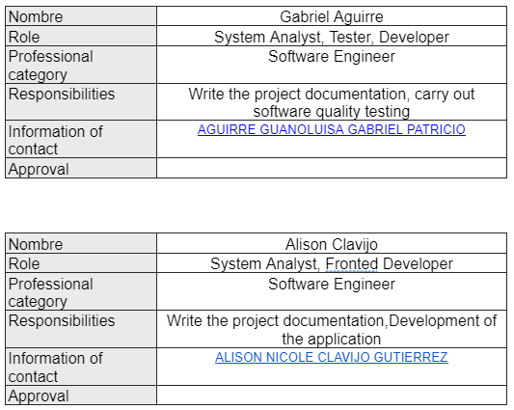
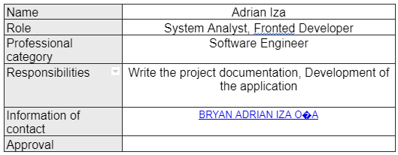

Slide 8
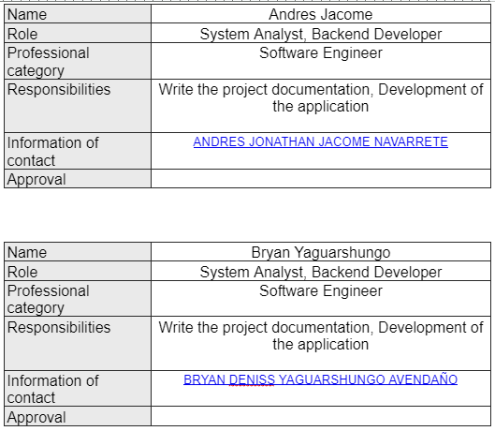

Slide 9
General description
04

Slide 10
Product perspective
Developed with REACT.
Focus on environmental responsibility.
Transportation and environmental impact.
Responsible tourist destinations and sustainable development.
Development team ensures usability and efficiency.
Documentation, design, implementation, and testing.

Slide 11
Product functionality
Sustainable travel planning.
Information about bicycle routes and hiking trails.
Responsible tourism.
Environmental impact reduction.
Storage of travel plans.
Efficiency and intuitive design.

Slide 12
Constraints
05

Slide 13
When designing and developing the EcoAdventure application system, there are several constraints to consider. These constraints may include:
The development methodology to be followed will be the Scrum methodology.
The platforms the application should be compatible with are mobile devices (iOS, Android) and web browsers.
The servers must be capable of handling concurrent queries.
The system will be designed following a client/server model.
The system should have a simple design and implementation, independent of the platform or programming language.

Slide 14
Functional requirements
06

Slide 15
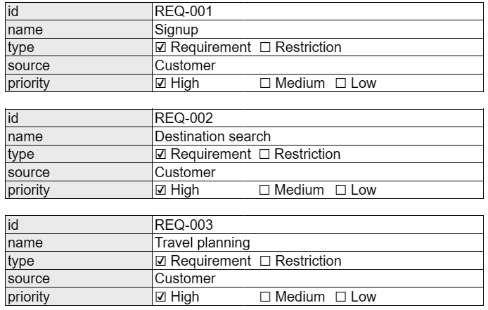
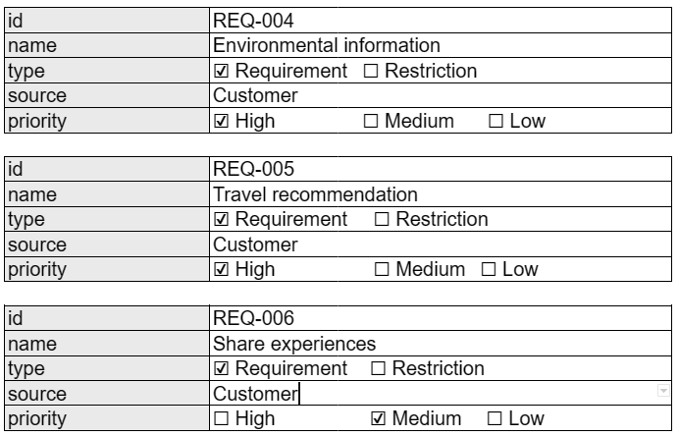

Slide 16
non-functional requirements
07

Slide 17
Performance requirements
Security
Reliability
Availability
Maintainability
Portability

Slide 18


Slide 19
Flowchart
08

Slide 20
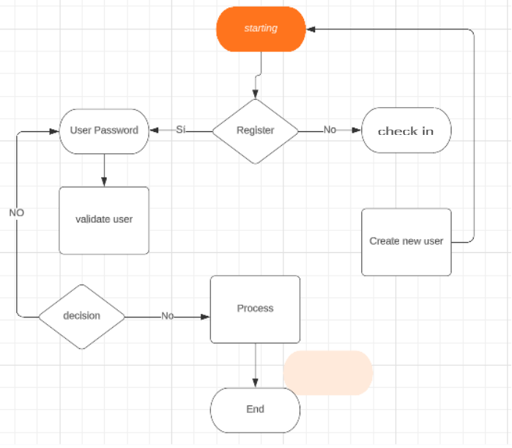

Slide 21
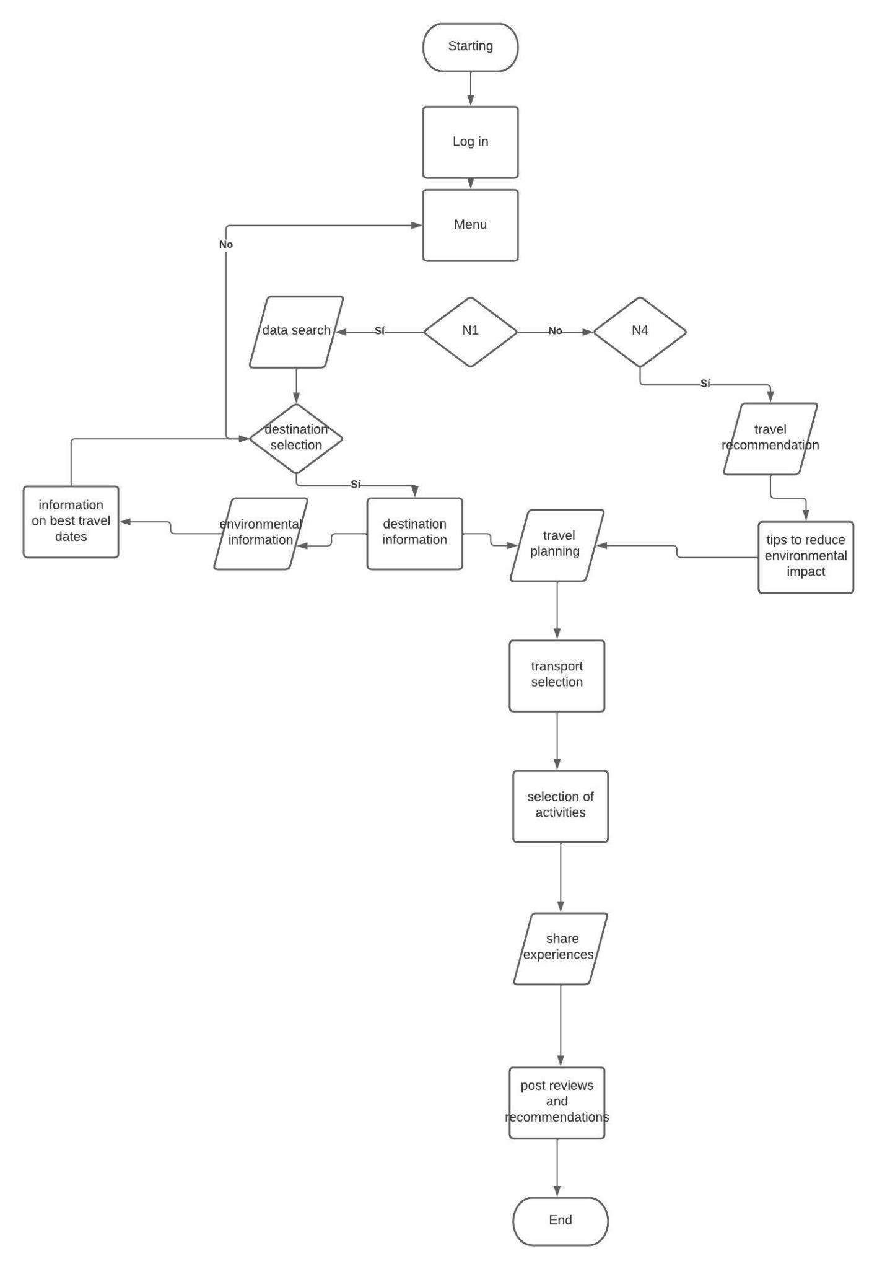

Slide 22
Class diagram
09

Slide 23
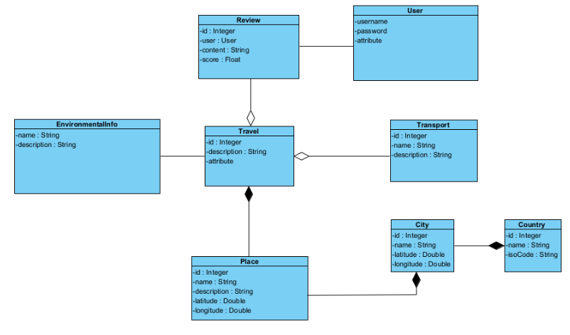

Slide 24
State diagram
10

Slide 25
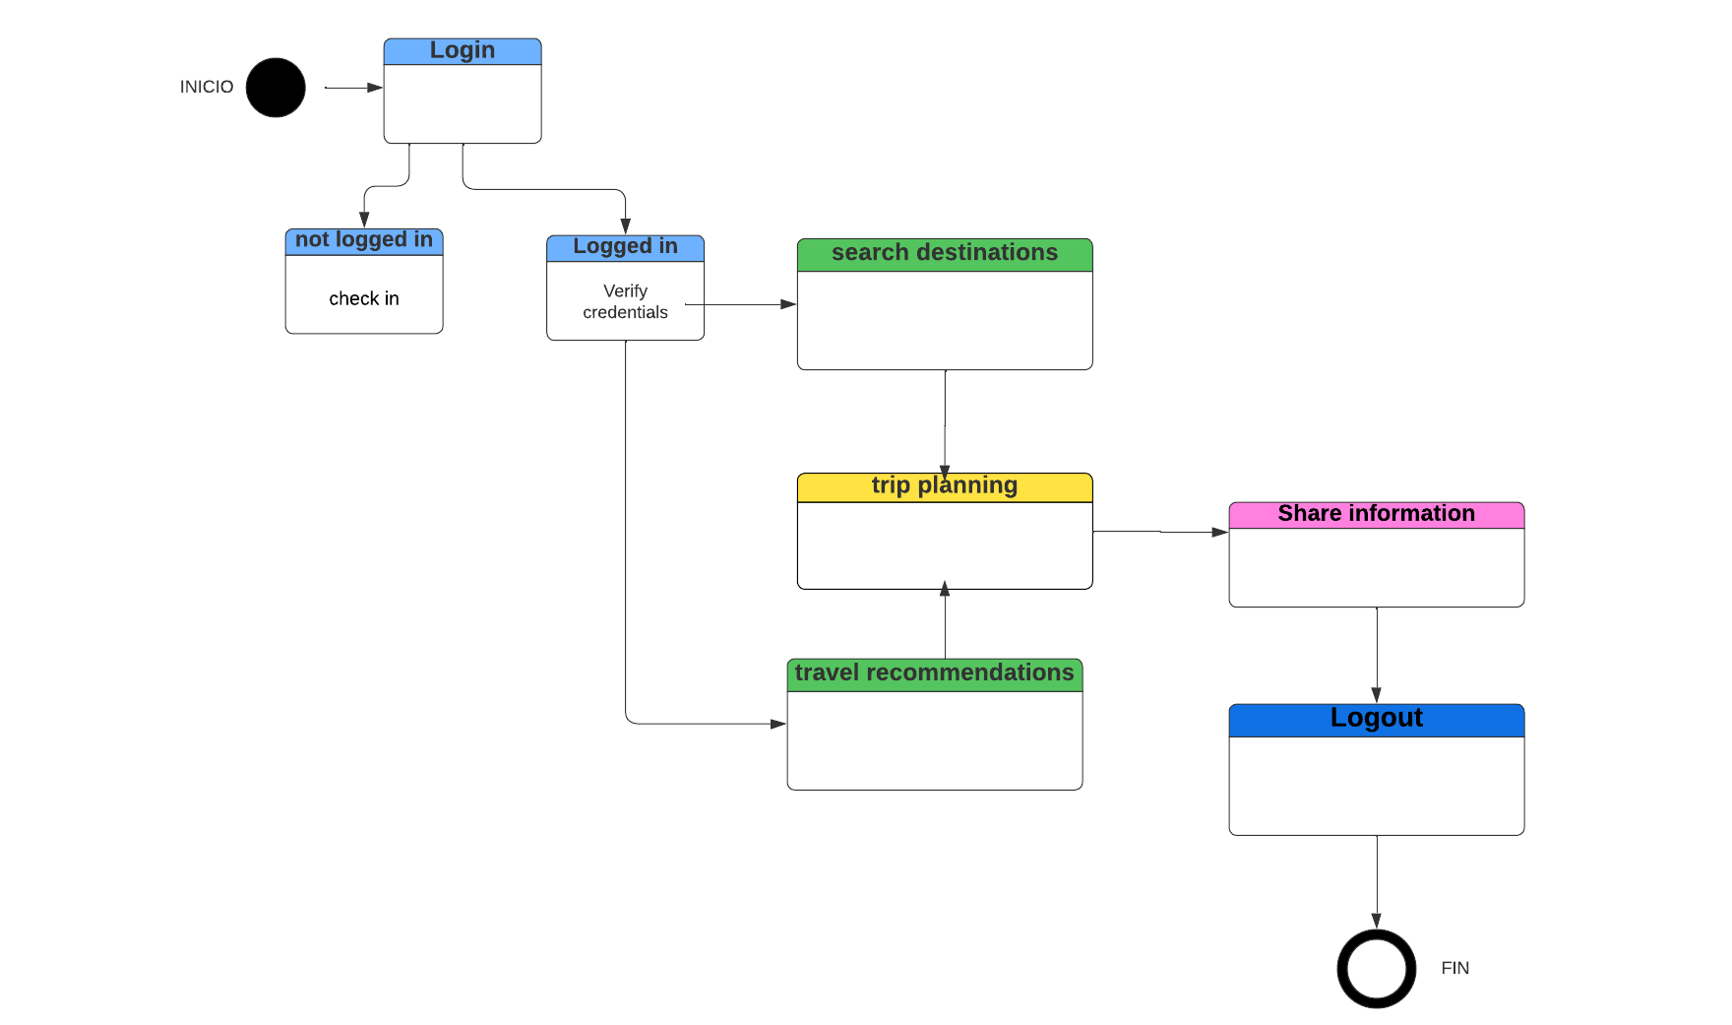

Slide 26
Sequence diagram
11

Slide 27
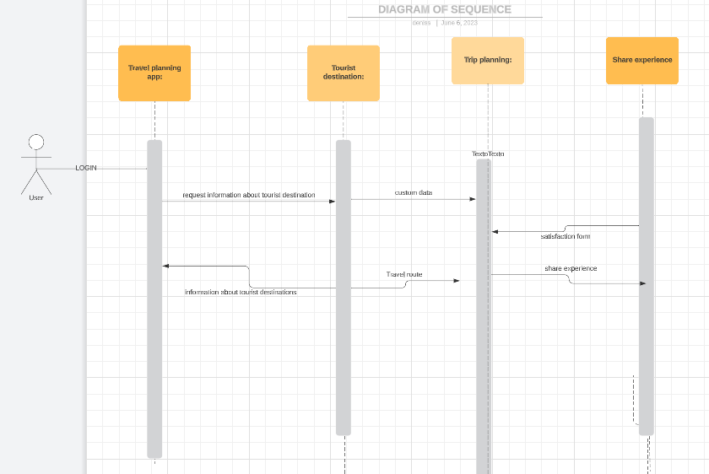

Slide 28
Conclusions
09

Slide 29
the present document IEEE 830-1998 has allowed for the comprehensive and systematic capture of the functional and non-functional requirements of the "EcoAdventure" application.
The process of documenting the requirements has been crucial in establishing a solid and clear foundation that will serve as a guide for the design, implementation, and evaluation of the application..

